Slide 1
EFFECTS OF PARENTS BACKGROUND/OTHER FEATURES ON STUDENTS PERFORMANCE
Understand the effects of parents background, test performance on students performance
N.B: All null values were filled with ZERO (0)

Slide 2
Findings
Looking through the dataset, the following features, had an effect on students performance :
Parental Level Of Education
Parental Job Status
Parental Wealth Classification
Test Preparation Course
Lunch
Other features like student’s identification, gender, race, where low/poorly correlated with their performance, was therefore not used.
The student’s performance(score) was grouped into two parts, (performance greater than 50%) and (performance from 50 and below)

Slide 3
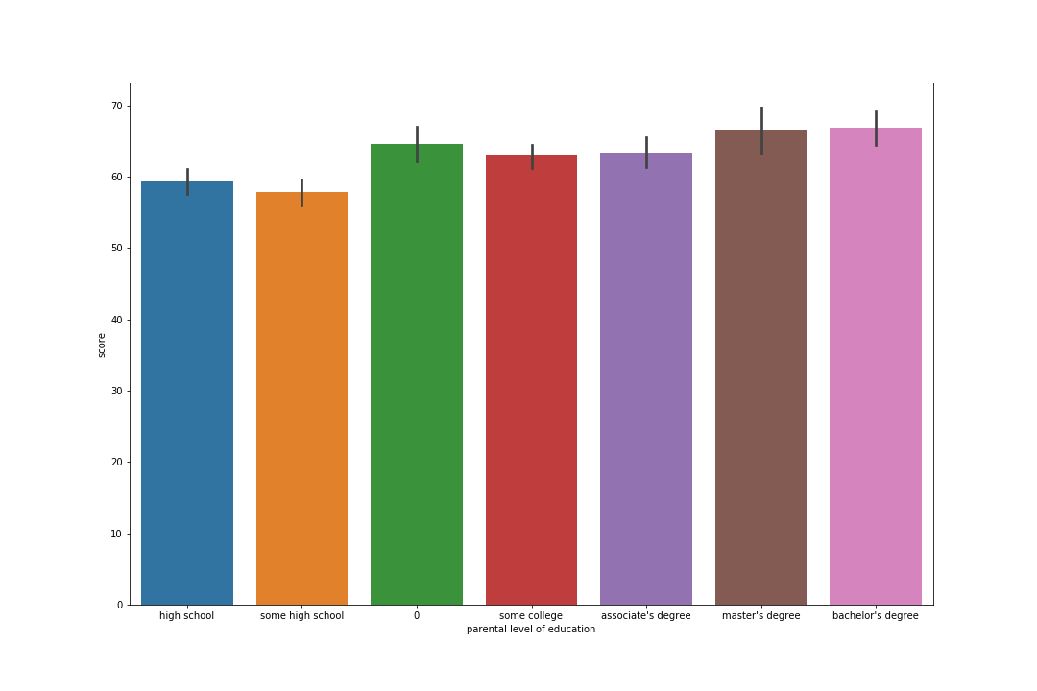
EDUCATIONAL LEVEL
Level of parents education, this had six (6) different categories:
Some college – 82.33% have a good performance
High school - 74.52% have a good performance
Some high school – 69.81% have a good performance
Associate’s degree – 83.52% have a good performance
Bachelor’s degree – 86.6% have a good performance
Master’s degree – 86.76% have a good performance

Slide 4
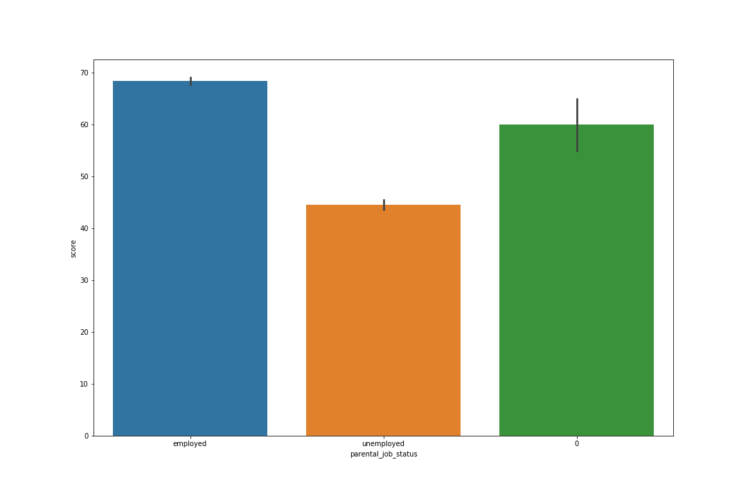
JOB STATUS
Job Status Of Parent was another criteria, grouped into two categories,
Employed
Unemployed
A total of 98.97% of children whose parent are employed, have a good performance score, only 23.0% of students, with parents from the unemployed category have a good performance score

Slide 5
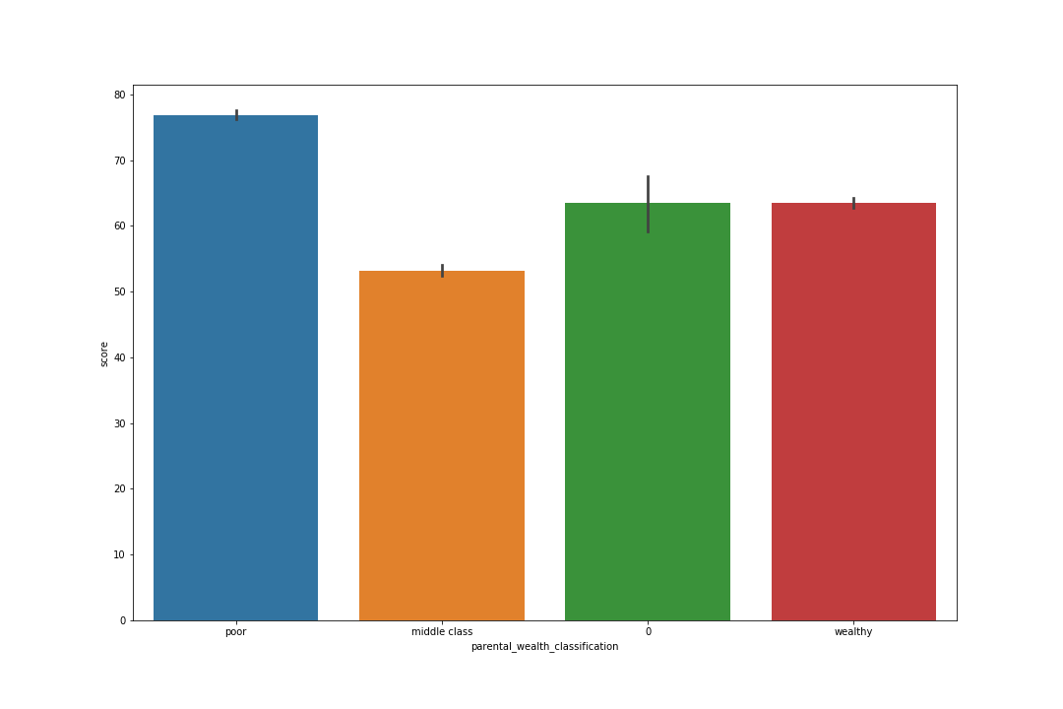
WEALTH CLASSIFICATION
This was divided into:
Rich
Middle Class
Poor
From the findings, 100% of children from poor homes have a good performance score, 63.99% of children with middle class parents have a good performance, 100% of children from rich homes have a good performance score

Slide 6
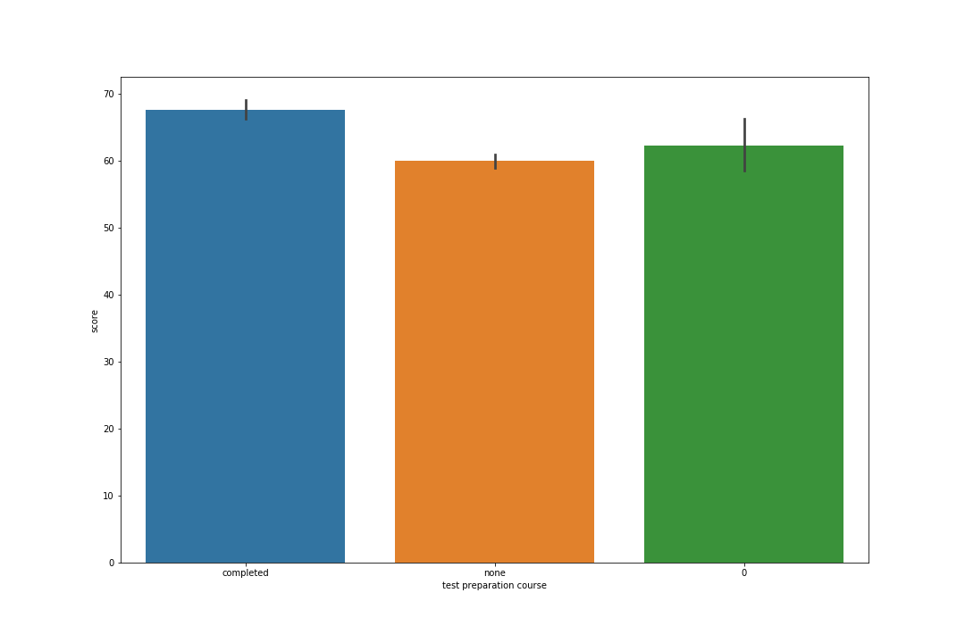
TEST PREPARATION COURSE
As we all know, this is a course in regards to preparing for an upcoming exam or test, it is most times not compulsory.
From the findings, 75.63% of student who did not take the course had a good performance, while those who took it had a percentage of 88.32% with a good performance.

Slide 7
RECOMMENDATIONS
Recommend good quality government schools for students whose parents are unemployed.
Recommend private teachers for students whose parents educational level falls in between (some college, high school, some high school).
From our analysis, students from poor homes do very well, they should be encouraged with scholarships to make education interesting and increase performance.

